Slide 1
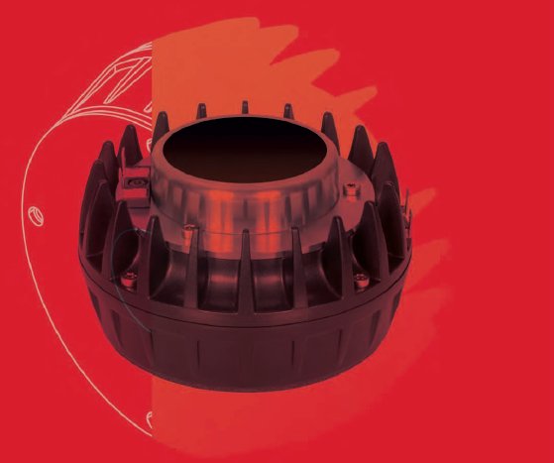

INVESTOR PRESENTATION

Slide 2
COMPANY OVERVIEW AND MARKET REFERENCE (1-17)
PRODUCTS & BUSINESS MODEL (18-22)
FINANCIALS (23-30)
EMINENCE AND B&C CHINA (31-38)

Slide 3
COMPANY OVERVIEW AND MARKET REFERENCE

Slide 4
COMPANY OVERVIEW
MARKET LEADER
B&C Speakers is a worldwide leader in the design, production, distribution and marketing of professional electro-acoustic transducers.
Designs and distributes loudspeaker components under the brand names B&C Speakers, Eighteen Sound, Ciare and Eminence and supplies branded and non-branded OEM components to relevant portions of the audio transducer market.
INTERNATIONAL DISTRIBUTION
B&C products are sold directly to OEM manufacturers around the globe, as well as through a network of distributors, with representation in more than 80 countries.
B&C has two direct-to-market distribution subsidiaries; in the United States (B&C NA) and in Brazil (B&C Brazil). Starting in 2021, in Reggio Emilia the Group created its European master distributor for all Group’s brands.
B&C Speakers has been listed on the Borsa Italiana’s Equity market since 2007, in the STAR segment since 2013.
2

Slide 5

COMPANY OVERVIEW
PRODUCTION OVERVEW
The R&D Department, with 10% of B&C’s 200 employees, is in constant cooperation with top Pro Audio OEM manufacturers across the world.
Five production buildings have been merged into a single, state of the art factory in Bagno a Ripoli (Florence) of more than 10,500 sqm. Additionally, B&C owns a factory of over 5,000 sqm in Reggio Emilia, Italy, dedicated to the manufacturing of Eighteen Sound and Ciare products; and factories in Eminence, KY, and Dongguan, China, manufacturing Eminence branded products.
The Group also owns two commercial subsidiaries, B&C USA and B&C Brazil.
B&C USA
18S
Eminence KY
B&C
B&C Cina
B&C Brazil
3

Slide 6



ARCHITETTURA SONORA
CRAFTED BY SOUND
Division of the B&C Speakers Group, Architettura Sonora is a revolutionary designer of unique, high-performance audio solutions and outdoor acoustic experiences, with an increasing imprint in the indoor world. AS, as we call it, has quickly become a pioneer in the industry
All products are manufactured “in-house”, guaranteeing quality and versatility. Each piece is individually and meticulously produced by skilled craftsmen, distinguished by sound quality, innovation, and tactile features that are rarely associated with speaker design.
4

Slide 7
REFERENCE MARKET
B&C components are typically applied in the Professional Loudspeaker Market, also known as “PRO”. Within this market, B&C primarily serves the Touring&Rental and Portable Sound market segments.
Some B&C transducers are also applied in the Automotive After Market, Installed Commercial Systems, Installed Leisure Systems, Hi-Fi, and Home Theatre markets.
With the acquisition of Eminence KY, B&C Group stepped into the MI market segment.
The total value of the addressable market for B&C Group products in 2022 was € 6,087M, and we are expecting it to grow to a value of € 7,706M in 2026.
Market to grow at a 5% CAGR (compound annual growth rate) in the medium term due to increased demand for high-quality, lighter and more high-performance audio, video, and lighting systems.
5

Slide 8
ADDRESSABLE
LOUDSPEAKERS
MARKET
AUTOMOTIVE
PRO
PROSUMER ELECTRONICS
COMMERCIAL AUDIO
OEM
AM
TOURING & RENTAL
INSTALLED LEISURE
PORTABLE SOUND
MUSICAL INSTRUMENT
HI-FI
HOME THEATRE
COMMERCIAL AUDIO
6

Slide 9


AUTOMOTIVE AUDIO – MARKET SEGMENTATION
AUTOMOTIVE
PRO AUDIO
PROSUMER ELECTRONICS
COMMERCIAL AUDIO
OEM
  Installed by car maker
AM
  Installed by car user
7
Notes:
Questa grandezza, con colore mercato di riferimento

Slide 10

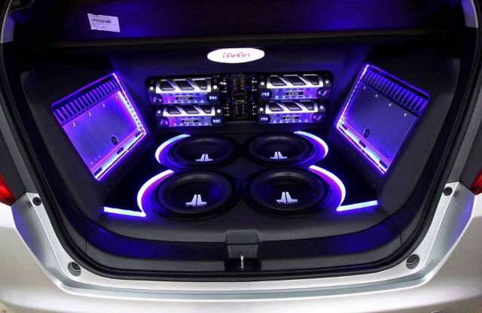
AUTOMOTIVE AUDIO – OEM AND AM
AUTOMOTIVE
PRO AUDIO
PROSUMER ELECTRONICS
COMMERCIAL AUDIO
B&C products are focused on the AM market. It is a market that has its maximum expression in Central and South America where cars and even motorbikes are transformed into portable discos.
It’s a massive market, and B&C group approached it with all portfolio brand.
€ 2000M
market value
8

Slide 11




PRO AUDIO – TOURING&RENTAL
AUTOMOTIVE
PRO AUDIO
PROSUMER ELECTRONICS
COMMERCIAL AUDIO
Touring
& Rental
  Touring & Concert
  Events
    Sports events
    Award
    Fashion shows
Installed
Leisure
Night club/Bars
Zoos
Theme parks
  Theatre Rental
Museums
Stadiums
Cinema
Music Instruments
(MI)
Guitar & Bass Guitar for musicians
Portable Sound
Mobile DJ
Weddings
Small events
9

Slide 12
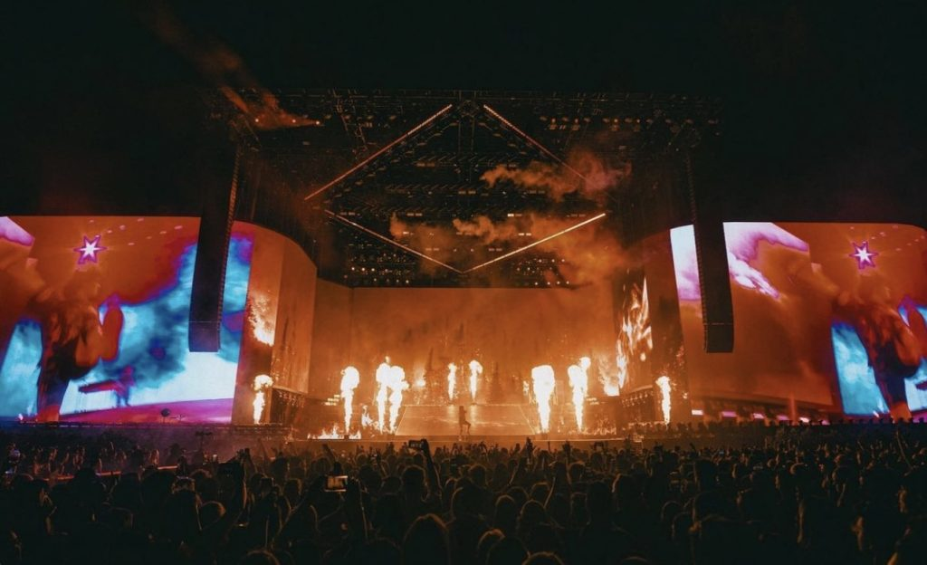
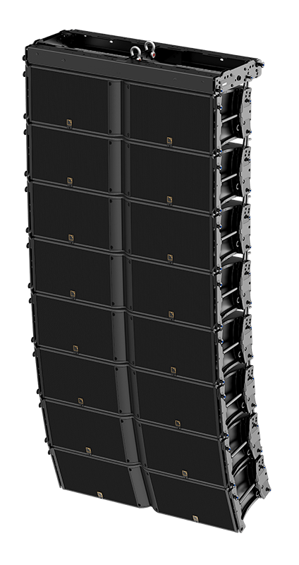
PRO AUDIO – TOURING&RENTAL
AUTOMOTIVE
PRO AUDIO
PROSUMER ELECTRONICS
COMMERCIAL AUDIO
During Covid was the most negatively impacted market due to pandemic restrictions. Market has been recovered the pre covid value and is expected to growth in the incoming years up to € 650M in 2026. The value of transducers is on average the 15% of the cabinet value. This is by far our core market that for us value at least 40% of our sales.
€ 450M
market value
10

Slide 13

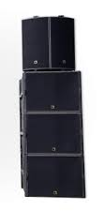
PRO AUDIO – INSTALLED LEISURE
AUTOMOTIVE
PRO AUDIO
PROSUMER ELECTRONICS
COMMERCIAL AUDIO
Barriers to entry: High
With return of spectators, sports stadiums are experiencing recovery. The upcoming year's slate of major sporting events can significantly increase pro audio sales. Olympics and Football World Cup can provide a major boost in sales. The impact of the pandemic was more negative for theatres, performing arts centers and music venues/nightclubs. Although there remains challenges, venue owners continue to upgrade solutions to attract better events and charge a premium. Houses of worship continue growing, especially in US that is by far the most important market. The market is expected to growth up to € 1,093M in 2026.
€ 832M
market value
11

Slide 14
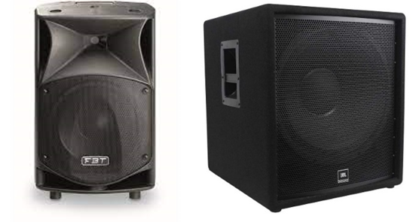

PRO AUDIO – PORTABLE
AUTOMOTIVE
PRO AUDIO
PROSUMER ELECTRONICS
COMMERCIAL AUDIO
Barriers to entry: High
During the last decade, the quality and performance level of Portable Sound and Musical Instrument Amplifier products has improved significantly. After a race to the bottom on selling prices at the turn of this century, the market is now demanding much higher performance products. Low-cost solutions are just not getting the job done, so many OEM companies are moving up market, and taking their consumers with them. The market is now seeing this evolution happen in emerging markets like China and India, where local made components are just not high performance enough to allow local OEM manufacturers to compete with European or North American alternatives. B&C is in an excellent position to be competitive in the mid to high end of this market segment, especially in areas where association with the B&C brand can benefit newer OEM companies.
€ 800M
market value
12

Slide 15
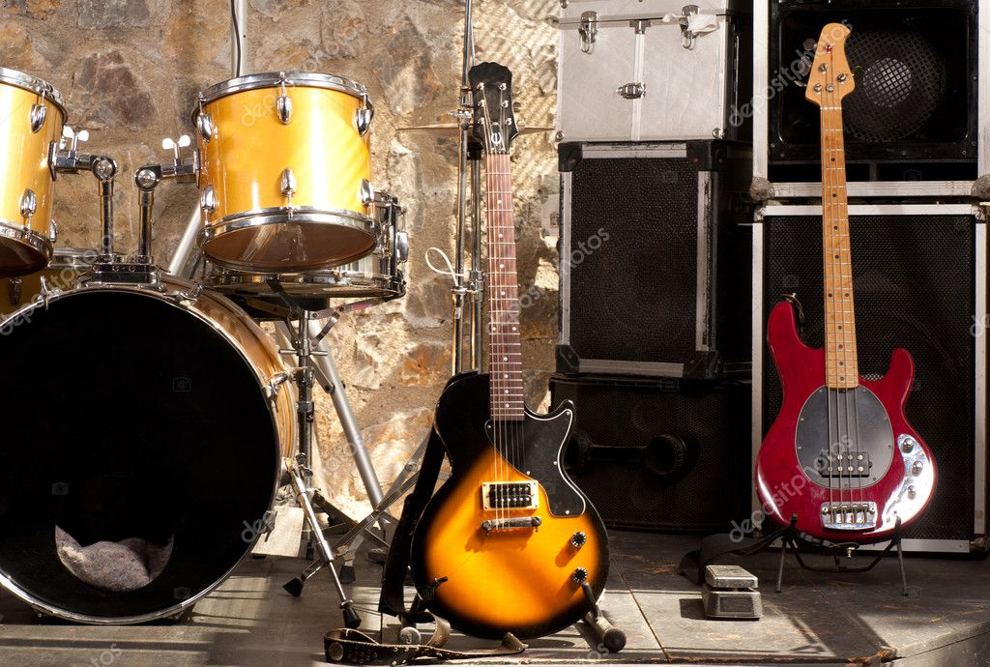
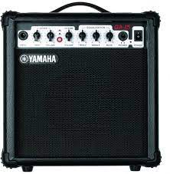
PRO AUDIO – MUSIC INSTRUMENT
AUTOMOTIVE
PRO AUDIO
PROSUMER ELECTRONICS
COMMERCIAL AUDIO
It's a market that grew significantly during Covid thanks to people's willingness to play at least at home. It's a huge market with high brand loyalty caused by musicians' demand for a specific sound. It is a new market for B&C group, and we will focus on it in the near future, thanks to the Eminence brand which enjoys a good reputation.
€ 2000M
market value
Barriers to entry: Medium
13

Slide 16


PROSUMER – MARKET SEGMENTATION
AUTOMOTIVE
PRO AUDIO
PROSUMER ELECTRONICS
COMMERCIAL AUDIO
Hi-Fi
Home Theatre
14

Slide 17
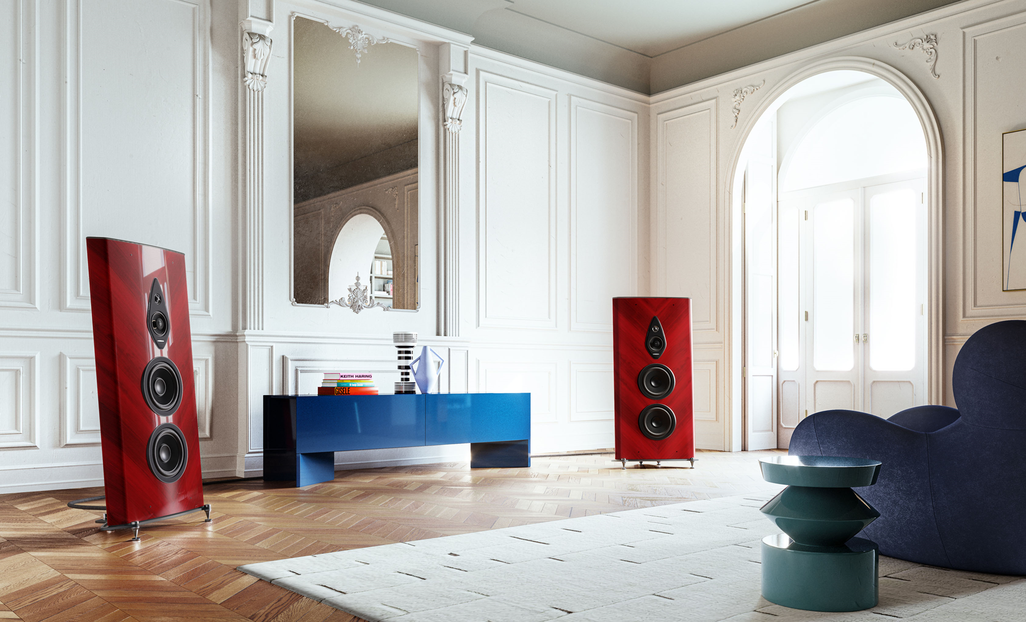
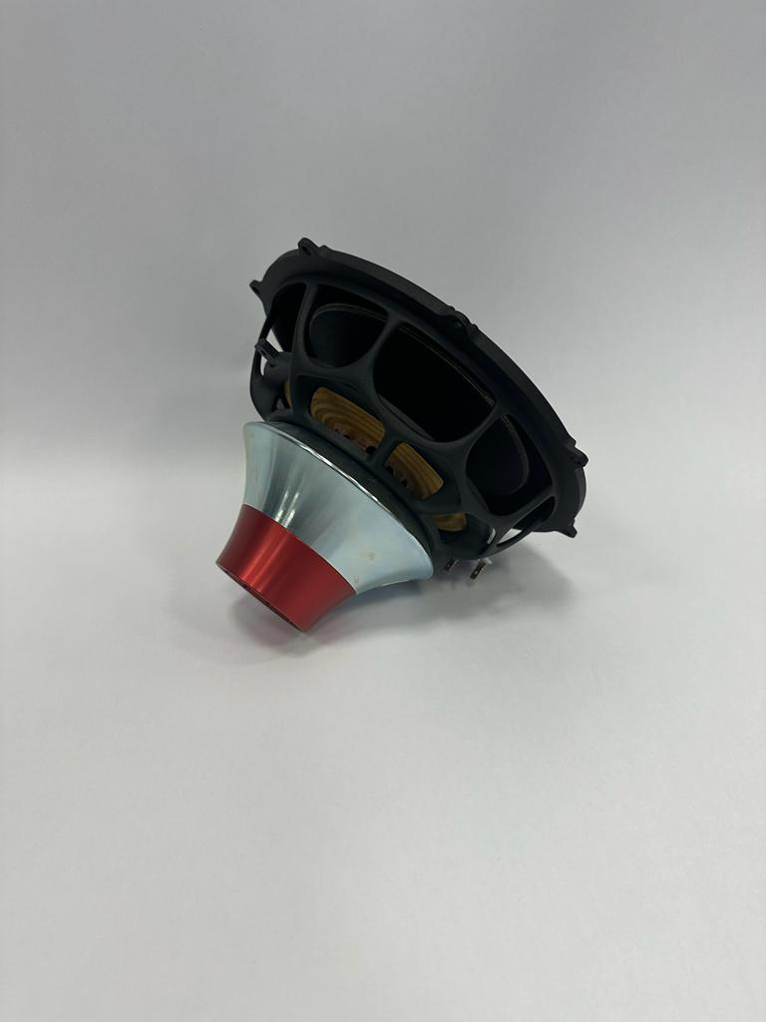
PROSUMER ELECTRONICS – HI-FI AND HOME CINEMA
AUTOMOTIVE
PRO AUDIO
PROSUMER ELECTRONICS
COMMERCIAL AUDIO
Barriers to entry: Medium
This market is an expression of quality in terms of sound and also in terms of the material used to build a cabinet. It is a luxury market and B&C products are positioned in the medium-high range. It is a market that has grown steadily in recent years and the prospects are to grow by another 20% until 2026 thanks to the continuous increase in sound integration with home technological systems.
€ 650M
market value
15

Slide 18

COMMERCIAL AUDIO – MARKET SEGMENTATION
AUTOMOTIVE
PRO AUDIO
PROSUMER ELECTRONICS
COMMERCIAL AUDIO
Commercial
Audio
Shopping centre
Hotels
Hospitals
Service stations
Exhibitions
Transportation
Malls
16

Slide 19

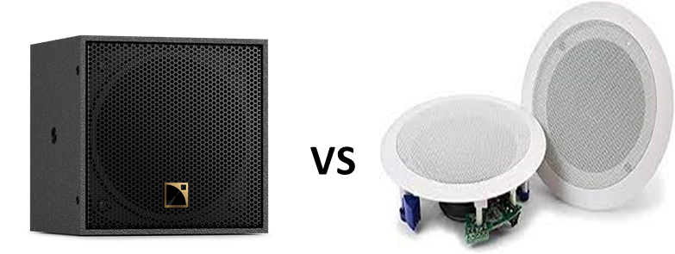
COMMERCIAL AUDIO
AUTOMOTIVE
PRO AUDIO
PROSUMER ELECTRONICS
COMMERCIAL AUDIO
B&C
reference customers
Ceiling
speakers
Installed Commercial demonstrated the most resilience during pandemic due to PA installations (transport, government buildings, high education). Continued positivity is expected in all that segment.
€ 717M
market value
Barriers to entry: Low
17

Slide 20
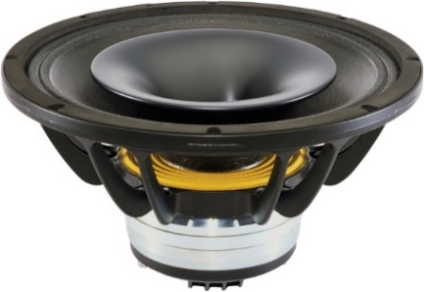
PRODUCTS &
BUSINESS MODEL
18
18

Slide 21
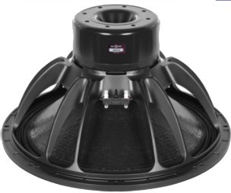
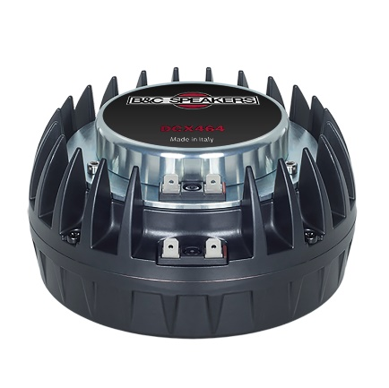
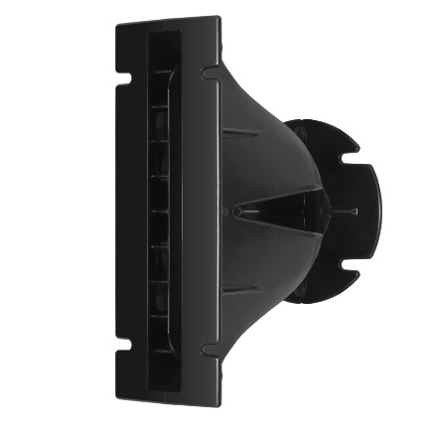
PRIMARY RANGE OF PRODUCTS
B&C’s products require higher technology, light weight, reliability, and consistently manufactured transducers, which B&C’s competitors cannot provide.
LOW FREQUENCY DRIVERS OR CONE DRIVERS 58%
B&C, the first to launch the HPL series in 1998, is today a leader in the development of neodymium woofers for the Pro audio market with four new series. In addition to having optimized frequency response curves, B&C newer woofers maximize power handling, excursion, and heat dissipation
HIGH FREQUENCY DRIVERS 27%
The use of Neodymium magnets in B&C high frequency drivers has not only allowed to dramatically reduce the size and weight, but also to improve performance and overall value
HIGH FREQUENCY HORNS 2%
The range includes constant directivity models, known for their great consistency in angular coverage, and exponential models that optimize acoustical load and sound energy transfer. Standardized diameters give designers the freedom to choose the best driver/ horn combination for each project.
COAXIAL COMPONENTS 13% COMBINED LOW/HIGH FREQUENCY DRIVERS
Coaxial loudspeakers combine the features of the best cone loudspeakers and compression drivers into a one-piece, point source solution. Their format enables electro-acoustical designers to build very compact and versatile systems.
19

Slide 22
BUSINESS OVERVIEW
NEW OPPORTUNITIES
CAR AUDIO MARKET
HI-FI
MI
NEW TRANSDUCERS
Since 2021, B&C Group is increasing its presence in the fast-growing Car Audio After Market segment, especially in US & Central America.
We are strengthening our position in the Hi-Fi market by developing dedicated products and establishing solid partnerships with the most prestigious brands.
Thanks to acquisition of Eminence KY, the Group finally stepped into the Music Instrument market segment.
Mosaic, a patented new transducer aimed to have multiple applications through all market segment.
20

Slide 23


BUSINESS MODEL
Output
CUSTOMERS and B&C R&D CUSTOMERS and B&C SALES
CUSTOM PRODUCTS
150/180 NEW PRODUCTS
AUTONOMOUS PROJECTS
CATALOGUE PRODUCTS
PER YEAR
Manufacturing & Assembling
Suppliers
Distribution channels
SINGLE PARTS BASED ON B&C PROPRIETARY DESIGN
INCOMING COMPONENT QUALITY CONTROL
FINISHED PRODUCTS 100% QUALITY CONTROL
INDUSTRIAL CUSTOMERS (>250)
DISTRIBUTION NETWORK
DISTRIBUTED IN OVER 80 COUNTRIES
5 PARENTAL COMPANIES:
18S; USA (2); CHINA; BRAZIL
21

Slide 24
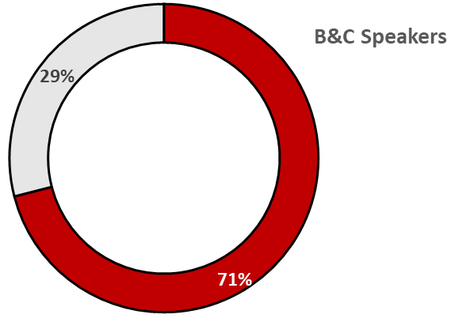











CLIENTS
Around 80% of the Company sales are of custom-made products, sold directly to these OEMs (Original Equipment Manufacturers). Whereas, the remaining share are catalogue products, that are sold by way of a wide network of distributors, with representation in more than 80 countries around the world.
B&C’s clients are professional audio system producers like Bose, Yamaha, Martin Audio, Nexo, D&B Audiotechnic, QSC Audio, L-Acoustics, Yorkville Sound, Turbosound, Meyer Sound, Electro Voice, etc.

Slide 25

FINANCIALS
23

Slide 26
FINANCIALS
KEY PERFORMANCE INDICATORS
2023 has represented the best year in terms of production and in terms of turnover in the whole B&C group history.
Number of goods produced (and sold) during the period are greater by 6.5% in respect to 2022 YTD.
Group EBITDA margin has slightly decreased (-1.4%) in 2023 YTD with respect to 2022 YTD, because it has been affected by € 1.016M of non-recurring costs related to M&A operations. Adjusted EBITDA margin (without non-recurring costs) hasn’t changed during the same period.
Group marginality is growing as well despite different problems to be managed (supply chain consistency, freight costs, energy costs).
REVENUES 2023
€ 94.02M
+14.5% vs 2022
EBITDA MARGIN
23%
ORDER BACK LOG
€ 21M

Slide 27
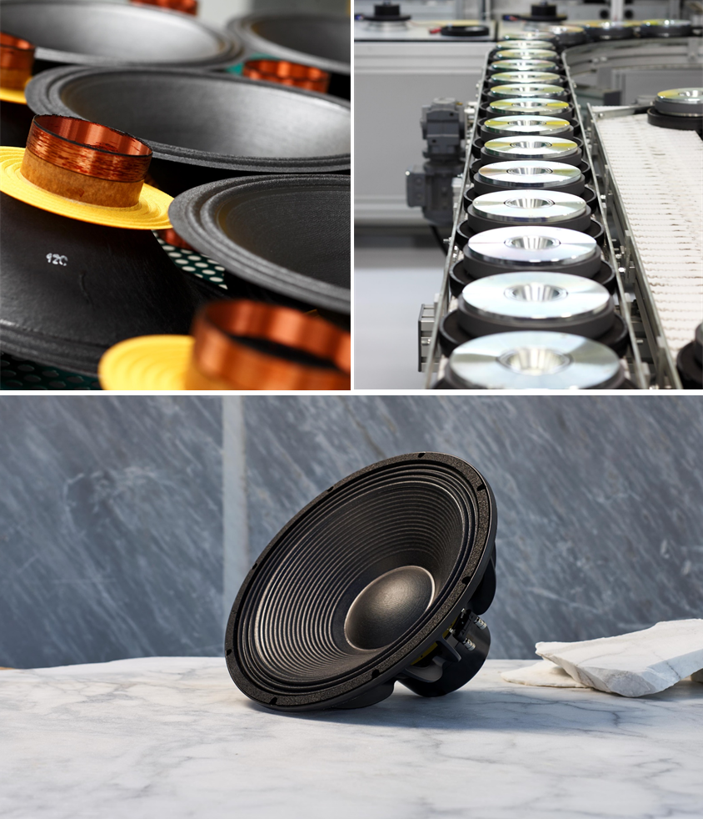
FINANCIALS
GROWTH PROSPECTIVES
B&C enjoyed unceasing growth with a record level of orders already confirmed for the end of current year.
The view for 2024, is positive, and additional growth is expected to be boosted by Eminence brand sales.
In order to fuel such additional growth, B&C is looking for new opportunities in term of facilities as well as for new suppliers for the most important components.

Slide 28

REVENUES - GEOGRAPHICAL BREAKDOWN
EUROPE
47%
NORTH AMERICA
19%
ITALY
6%
ASIA
PACIFIC
18%
MIDDLE EAST
1%
LATIN AMERICA
9%

Slide 29
TOP-LINE EVOLUTION
GROWTH PROSPECTIVES
In 2023, the Group has shown record revenues for the second year in a row. The turnover for year 2023 has been € 94M.
Eminence contribution to the final figure amounts to € 2.3M (stemming from September 2023 to December 2023 revenues).
The budgeting process for 2024 shows us that the prospect is for a 13% growth in revenues, driven by the contribution of Eminence and B&C China.

Slide 30
P&L CONSOLIDATED
P&L ANALYSIS
Gross Margin showed a slight improvement (+0.5%) due to a greater effenciency of the operating structure together with the downsize of transportation costs.
Ebitda was impacted by the acquisition of Eminence for € 1.016M, so Ebitda Adj recorded a figure of 24.3%.
However, net result remained fairly stable at 14.8%.
36,9%
36,4%
38,6%
24,7%
23,2%
22,3%
35,5%
22,1%
20,8%
18,3%
32,6%
19,0%
14,9%
14,8%
15,4%
16,0%
14,5%
11,3%
9,0%
5,2%

Slide 31
QUARTER ECONOMICS
QUARTER ECONOMICS
2023 has shown quarters similar to the best ever recorded in B&C Group history.
Last quarter of 2023 has followed the same trend thanks to the additional work force implemented by B&C during the year.
On top of that we have to considered the new revenue from Eminence acquisition.

Slide 32
CASH FLOW GENERATION & DIVIDEND POLICY
FCF produced per year (€M) 2010 - 2023
CASH FLOW GENERATION
In 2023 B&C Group has recorded the best FCF result in its history, € 18.3M.
This results represents the sign of a full-recovery after the pandemic (which affected 2020 and 2021, directly, and 2022) and highlights a very positive trend in the last 13 years (black-dotted line).
The company's ability to produce consistent cash flows is reflected in the FCF/Ebitda conversion ratio, which shows the repeatability of the result over the years.
B&C keeps focusing on having a generous dividend ratio to shareholders.
Cash Flow Conversion Ratio 2010 - 2023

Slide 33
EMINENCE
B&C CINA

Slide 34



Acquisition Recap
EMINENCE SPEAKERS
As of 07/09/2023, B&C Speakers S.p.A. acquires 100% of the share capital of Eminence Speaker LLC, based in Kentucky, U.S.A., from Eminence Holding LLC and, simultaneously, B&C Speakers S.p.A. signs a binding commitment to purchase the assets of Eminence Dongguan Enterprise Co. Ltd (APA, Asset Purchase Agreement), a company based in Dongguan, China, entirely controlled by Eminence Holding LLC.
As of 01/12/2023 the NewCo called B&C China acquired assets from Eminence Dongguan Enterprise Co. Ltd. These represents an operation aimed at acquiring the production factors that are considered strategic to consolidate and expand, through additional investments, the business volume achieved on the Asian market by the Eminence brand.
The consideration agreed for the two transactions described above is $ 4,495,000 and B&C Speakers financed it by using its own financial resources.

Slide 35
EMINENCE SPEAKERS
Distribution channel synergies
OEM relationships
Pension Fund
closeout
Production monitoring
Production synergies
Costs synergies
The Group aims to exploit synergies achievable on the cost, production and distribution channel side. These synergies are achievable at (almost) zero cost. The goal will be to find the most efficient mix that can maximize benefits without overburdening the organizational structure.
At the same time, the Group intends to reshape policies with North American OEMs, working primarily on the quality and image of the product offered. To do this, monitoring of the production structure in Kentucky will be necessary in order to define areas of intervention.
Finally, the Group considers it worthwhile to liquidate Eminence's Pension Fund, with a view to hedging financial risks.

Slide 36
CASE HISTORY – 18S
2017
2023
Eighteen sound srl with its subsidiary Sound&Vision, owner of the historical Ciare brand, was acquired by the B&C Group in September 2017 for € 7M.
The strategy implemented since the first year of acquisition has focused on the following aspects
In 2023, the Sound Group generated revenues of approximately € 22M, with a growth of 60% compared to 2017 and a CAGR of 8%.
Expanding the sales force
Integration of the supply chain within the B&C logic
Change of production logic from 'per stock' to 'per order'
Strengthening the technical department
The acquired group generated approximately € 14M in revenue in 2017, with an EBITDA of 7%.
Both brands (18S and Ciare) have seen their customer portfolios grow, especially OEM customers, thanks to a renewed offer in terms of products and technologies.
Financially, the company was also in trouble, with a negative NFP of around € 7M and a cash flow that was also negative and amounted to € -2.5M.
Profitability in 2023 was 16% of revenues, more than doubling the pre-acquisition profitability. Capitally, the company was also strongly strengthened with a positive NFP of € 1.3M and cash generated in 2023 alone of € 4.4M.

Slide 37
EMINENCE SPEAKERS – INVESTMENT PLAN
BENEFITS $ 2.24M
Cash and Annuity payments;
Health insurance savings
WAREHOUSE $ 0.17M
FACILITY $ 0.33M
NEW INVESTMENTS
SAFETY $ 0.26M
Extend Sprinkler System to press area;
Repair retaining walls, add fall protection
PRODUCTION $ 0.24M
Estimated tooling run rate for purchased parts
CAPITAL $ 0.6M
Safety Stock inventory for purchased parts;
Working capital

Slide 38
PROSPECTIVES – EMINENCE AND B&C CHINA
2024
2026
In 2024, B&C Group expects to benefit a straight-away (conservative) € 13.5M contribution from its new two business entities.
Reiteration of the strategy deployed with 18S
Significant increase in sales, especially for B&C China, which could show prospects of doubling sales as early as 2025, with EBITDA trending towards that of 18S.
Expanding the sales force
Integration of the supply chain within the B&C logic
Change of production logic from 'per stock' to 'per order'
Strengthening the technical department
Eminence's activities will focus on rationalising costs and implementing planned investments. At the same time, the Eminence brand will immediately contribute to strengthening the Group's presence in its target markets.
In the commercial area, the Group will benefit from the historical presence of the Eminence brand and investments in the marketing area to penetrate the MI market (market value € 2,000M).
B&C China 2024 forecasts highlight very positive results in terms of I Margin (35.8%) and EBITDA (14.9%).
Significant increase in margins thanks to the production logic 'per order', which will lead to lower inventory costs, and the exploitation of synergies, which, together with the shortening of the production chain, will make the distribution structure more efficient.

Slide 39
SHAREHOLDERS
Equity Shares
Research&Development International s.r.l. has non-contestable control of B&C Speakers and exercises it through its CEO and owner, Lorenzo Coppini.
Data updated to 30/09/2023. The equity share of R&D remains at 54%. The remaining shares may deviate from the figure shown.

Slide 40
SHARES – PRICE AND VOLUME

Slide 41



CONTACTS
Investors Relations:
Lorenzo Coppini-CEO
Francesco Spapperi-CFO
Davide Norelli-Controller
E-mail:
investors@bcspeakers.com
Office:
Via Poggiomoro, 1 – Vallina, Bagno a Ripoli (FI), 50012, Italy
Phone: +39 055 6572303

Slide 42
SAFE HARBOUR STATEMENT
Certain statements in this slide show, including those addressing the Company’s beliefs, plans, objectives, estimates or expectations of possible future results or events, are forward-looking statement.
They are based on the assumptions, beliefs and expectations of our management team as of the date this slide show was prepared.
Forward looking statements involve known or unknown risks, including general economic and business conditions, and conditions in the industry we operate. Forward-looking statements may also be affected if our assumptions turn out to be inaccurate.
Consequently, no forward-looking statement can be guaranteed and actual future results, performance, or achievements may vary materially from those expressed or implied by such forward- looking statements.
For additional information concerning other factors that may affect the Company’s current and future business, results of operations and financial condition, we suggest you review the Company’s filings with Borsa Italiana. The Company undertakes no obligation to update the forward-looking statements to reflect events or circumstances that may arise after the date hereof.

Slide 43
THANK YOU

